Slide 1
Clustering Analysis and Recommendations for Patient Wellness Program
Subtitle: Lab Report 3 – Master’s in Business Analytics
Presented by: Rishu Dixit – Northwood University
Date: June 22, 2025
Professor: Itauma Itauma

Slide 2
Objectives & Abstract
Apply clustering techniques to patient wellness data
1
Identify behavioral patterns and lifestyle segments
2
Tailor wellness programs to specific patient groups
3

Slide 3
Dataset Overview
Key Features: Age, Stress Level, Sleep Hours, Physical Activity, Healthy Meals
Preprocessing: Null value handling, data type conversion

Slide 4
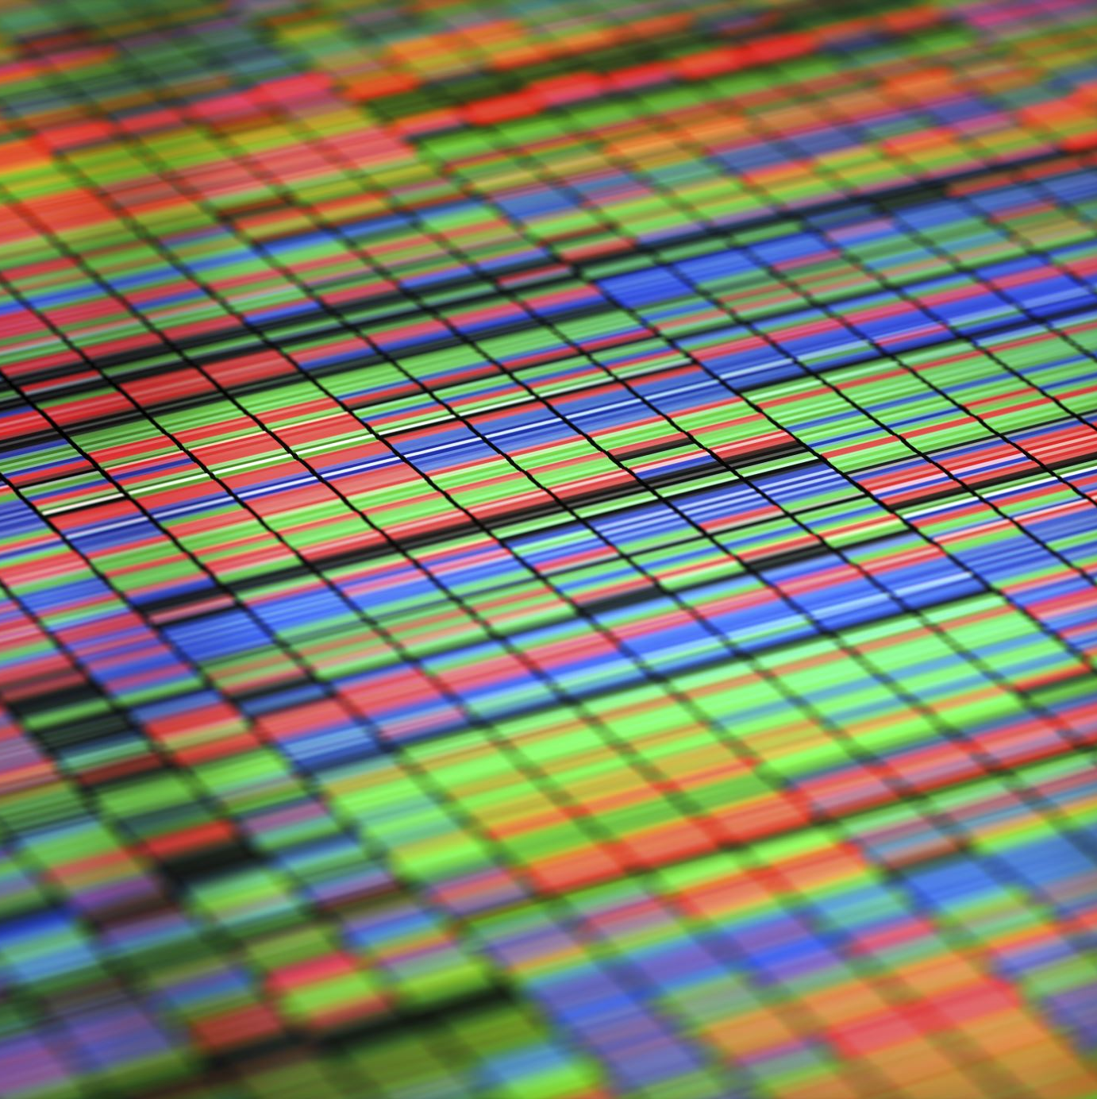
Exploratory Data Analysis (EDA)
Box plots to identify outliers
Heatmap to assess feature correlation

Slide 5
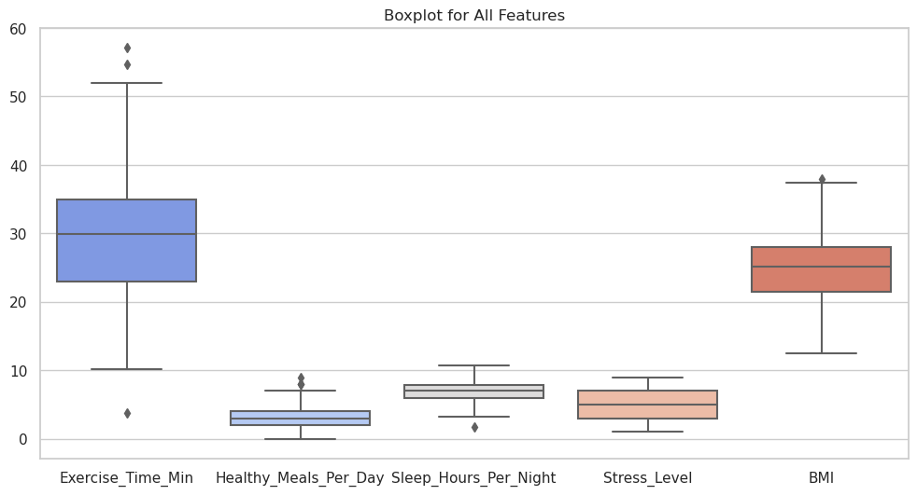
Box Plot

Slide 6
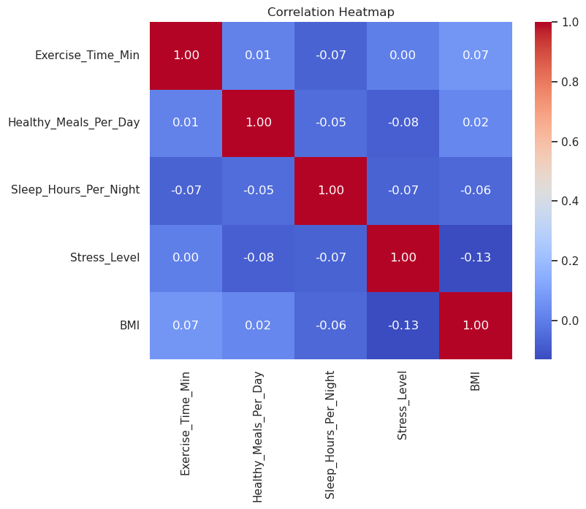
Heat Map

Slide 7
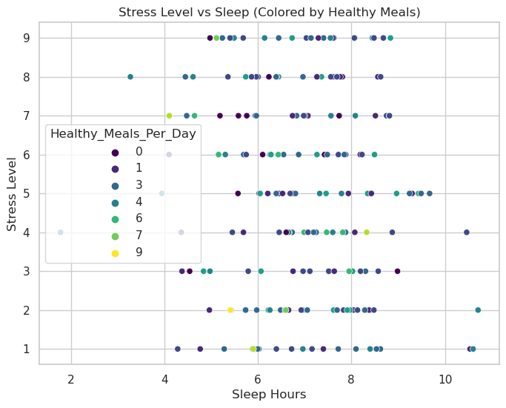
Standardization & PCA
Z-score normalization
PCA for dimensionality reduction

Slide 8
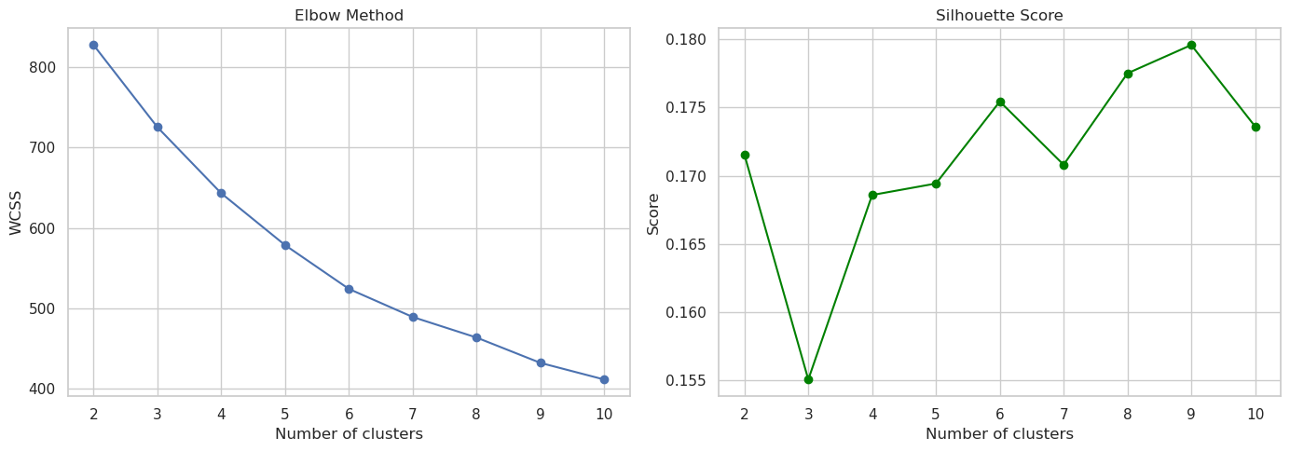
Clustering Techniques

Slide 9
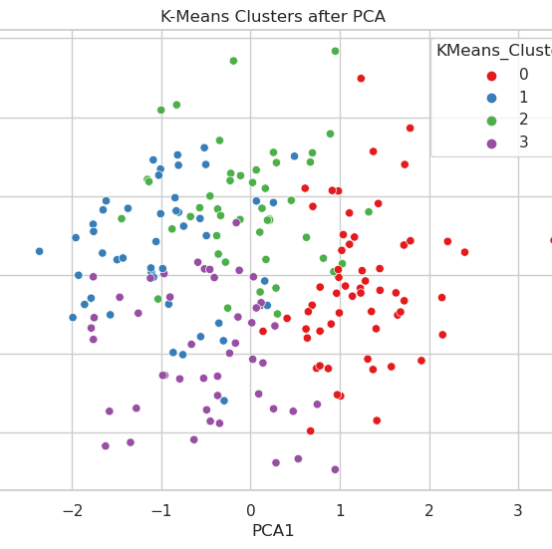
Cluster Insights
Cluster 0: Healthy lifestyle, low stress
Cluster 1: High stress, poor sleep
Cluster 2: Young adults, inconsistent habits
Cluster 3: Older adults, structured wellness routines

Slide 10
Recommendations
Cluster 1: Mindfulness and sleep therapy
Cluster 2: Gamified nutrition apps
Cluster 0: Peer support and ambassador roles
Cluster 3: Chronic care and maintenance

Slide 11
Conclusion
Clustering revealed key patient segments
Personalization improves wellness outcomes
Next step: integrate real-time wearable data

Slide 12
References
APA, WHO, McKinsey (2024–2025)
Scikit-learn, Seaborn, Jupyter
NEJM, Nature Medicine

